Slide 1




One Stop Services
www.prime-consultancy.com
Email: info@prime-consultancy.com
Phone: (+62) 21 2276 71 37

Slide 2


PRIME Mission:
PRIME Consultancy is a corporate management consultant and property development specialist, based in Jakarta, Indonesia’s capital and center of the most important domestic economic zone.
PRIME Consultancy, established in January 2011, is headed by Mr. Jochen Sautter as its President Commissioner and co-owner. His wife Dewy Martikasari is the current President Director. Our extended experience and network capacities established over more than 25 years have been very helpful guiding many companies through the Indonesian business jungle successfully. Most common and our specialty is to provide market research, establish and administer companies and representative offices, attend to human resource needs like recruitment and advise on property matters.

Slide 3
PRIME Services:
Our advisory portfolio is defined as a One-Stop-Service Provider functioning as a Single Interface for our mostly international clients across all industries – from understanding potential target markets to setting up business operations Indonesia cost efficiently and timely.
Besides PRIME Consultancy there was also for international projects PRIME Nusantara Corporation set up in Labuan, Malaysia in 2020.

Slide 4

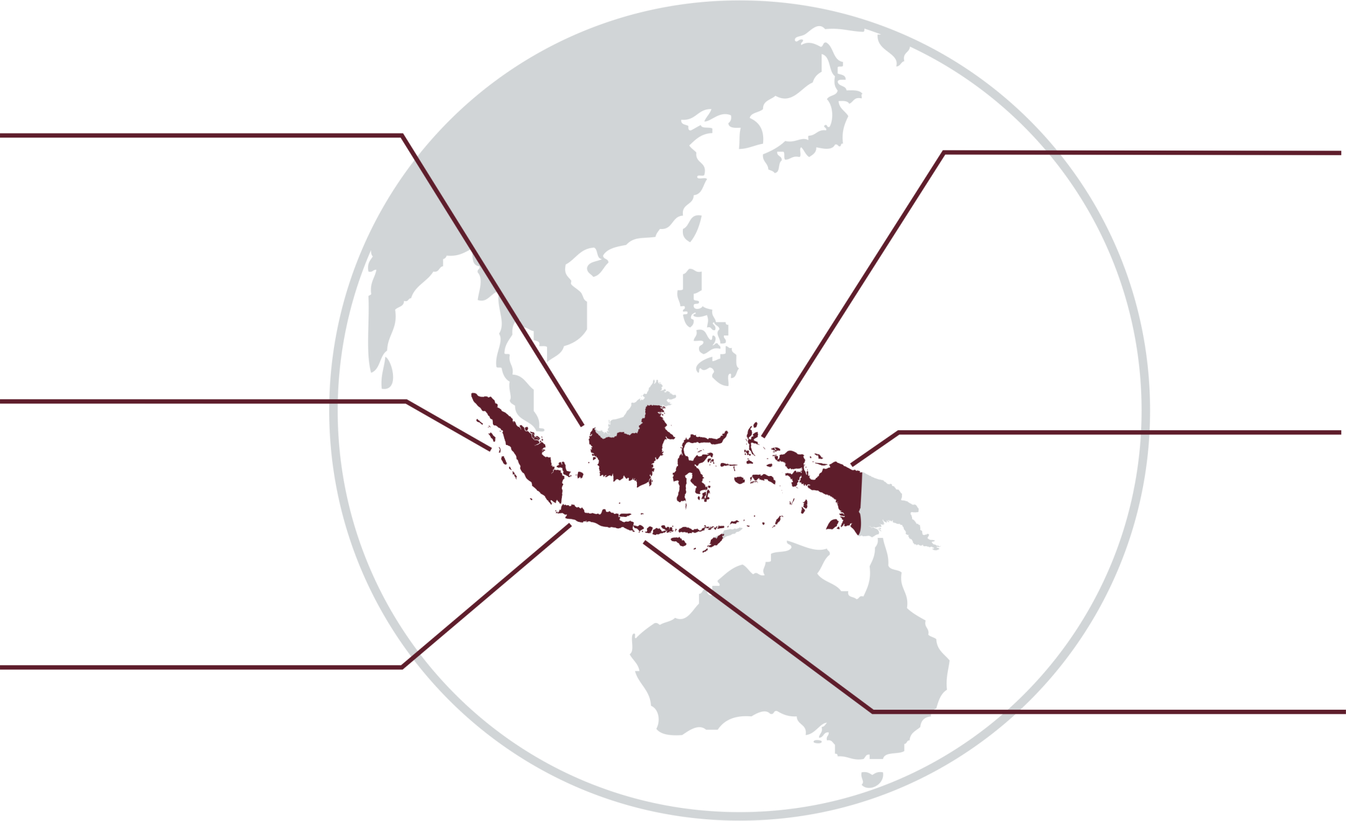






Indonesia In Digits.
284+ million
Indonesians
66% of population
belong to middle class
call the largest archipelago in the world their home.
young Indonesians are driving the economy.
USD 1 trillion
GDP
Stable 5%
GDP growth
ranks the economy as the largest in Southeast Asia.
ensures a strong role amongst G20.
+65% improvement
in Doing Business
Up to 67%
import dependency
over 9 years by rank
(from 128 to 27 in 2024).
rate of local industry sectors.
Notes:
USD 1 Trillion GDP
Makes the economy the largest in Southeast Asia.

Slide 5





Common Challenges.
Market
Intelligence
Scarcely public available information is often outdated, lacking in reliability and needs to be pieced together from various sources.
Bureaucratic
Procedures
The regulatory framework offers many stumbling stones in practice for newcomers which need to be avoided via an efficient setup.
Local Presence & Business Culture
Sustainably doing business in Indonesia means to be present on the ground and grasp the diverse local culture.

Slide 6


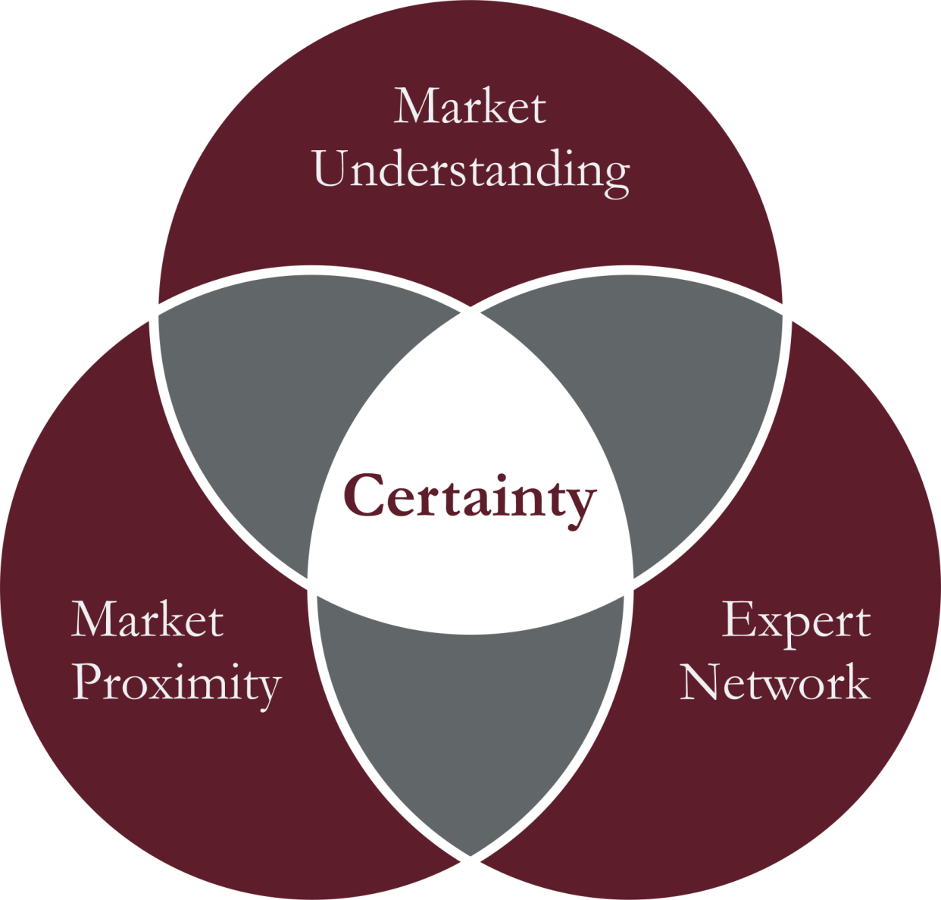
Our Approach.
Instead of being specialized on a single industry of Indonesia, we focus on solving common challenges of foreign companies systematically along their journey of entering markets.
Our key for excellent customer service is to create certainty based on three pillars:
We developed a deep market understanding across the industries through long-term market observations and experience with bureaucratic procedures.
We access a broad network of experts and partners with firsthand industry knowledge and services.
We leverage on our market proximity and being next door to decision makers.
Highly specific market researches or other requests are served jointly with our trusted partners, external consultants and service provider as subject matter experts in their field.
Our priority is to always effectively solve the challenges our clients are facing. Based on reliable information and partners, we create certainty about your next steps into the new market.

Slide 7

Core Competences.
Market Intelligence Research
Entry Strategies Analysis
Business Partner Identification &
Company Representation (Sales Agent)
Company Establishment and Setting Up Representative Office
Corporate Secretarial Services & Administration Support
Interim Management
Market
Entry
Corporate Services
4 Core
Competences
Facility Management Assistance & Commercial Promotion
Identify Office Space and Production Sites
Property Investment for Corporate & Private Investors
Recruitment of Top and Middle Management Candidates
Business Culture Coaching
Optimizing Employment Agreements & Handbooks
Property Advocacy
HR
Services

Slide 8
One Stop Service.
Finance Solutions for Your Indonesian Buyer
Export Credit Finance (ECA) facilities for Indonesian buyers
Long Term Financing
Leasing Solutions
Get Your Business Operations Started
Interims management & Corporate Secretarial Services
Find Your Suitable Office
Identify and benchmark office space and production sites
Virtual Offices and Administration Services
Understand Your Market
Market research and entry strategy
Business Visit Support
Entry
Success
Your Market Presence via Agents or Partner
Company representation (Sales Agent)
Business Partner Identification, i.e. distributor matching
Find Your Local Team
HR Recruitment
Work Permit Assistance
Business coaching on Indonesian culture
Establish Your Own Market Presence
Company or Representative Office Establishment
Core Competences:
Market Entry
Financial Advisory
Property Advocacy
HR Services

Slide 9
































Some of our Valued Clients.

Slide 10
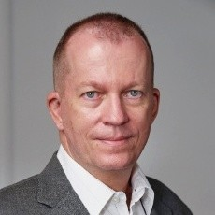


Behind the Scenes.
Jochen Sautter
Curriculum Vitae
8/2013 – present: PT PRIME Consultancy
Position: President Commissioner and Owner (July 2025 onward)
Co-Founder & President Director (2013 to 2025)
Type of business: Advisory for Market Entry, Human Resources Development
Property development, management and brokerage;
3/1997 – 4/2013: PT German Centre Indonesia
Position: President Director
Type of business: Business Incubator for German SMEs by L-Bank
3/2010 – 3/2013: EuroCham Indonesia
Position: Vice Chairman
Type of business: European Business Chamber of Commerce Indonesia
8/2004 – 5/2006: EKONID
Position: Member of the Board
Type of business: German-Indonesian Chamber of Industry and Commerce
3/1995 – 2/1997: L-Bank
Position: Project Management / Assistant to the Board of Directors
Type of business: Development Bank of State Baden-Württemberg
10/1988 – 5/1994: University of Mannheim
Diploma in Business Administration (Diplom-Kaufmann)
Business incubator, Generalist on Management & Property Specialist.
Jochen Sautter arrived in Indonesia in 1997 to establish and manage the business facilitator 'German Centre for Industry and Trade' and had been its Managing Director until April 2013. Then he hosted over 160 corporations, supported their endeavors of developing business to be successful and turned the German Centre into a key-contact-point of entrepreneurs engaging in all sorts of Indonesia's business sectors.
Shortly into the new millennium he served in addition as a Member of the Board of EKONID, was Vice Chairman of EuroCham in Indonesia and implemented some children-oriented tsunami relief projects in Aceh.
Jochen Sautter was Co-Founder of PRIME Consultancy in 2011 and had been President Director between 2013 and 2025. His management expertise is broad with special focuses on incubation, property and business development challenges.

Slide 11

www.prime-consultancy.com
Email: info@prime-consultancy.com
Phone: (+62) (21) 2276 7137

